Slide 1

We are a newly formed project team. Based on the existing academic curriculum planning support system, we are launching a project to further improve its functionality and user experience.
Million Coursework Students
Team Members:
Kundu Gui | Project manager
Rui Zhang | Developer and Risk Manager
Sayed Zulfikar | UX Designer
Zifeng Liu | Developer
Xiangyu Chen | Developer
Lingyu Xia | Developer
Yichen Li | Client Liaison

Slide 2
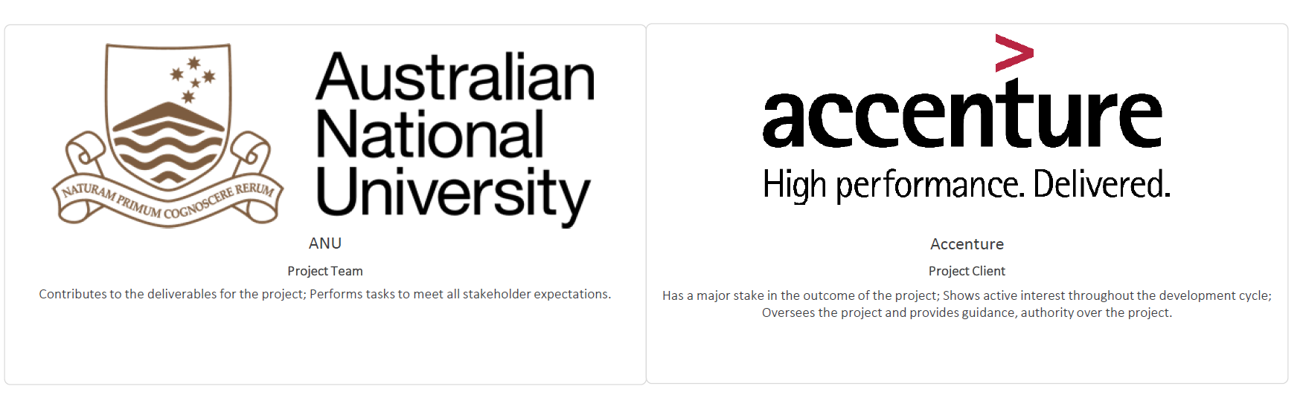
This project will upgrade the former course selection project in many fields including improving Graphical User Interface (GUI), offering access control for ANU stuff and former bugs fixing. Students could select personalized course depending on their interaction with website and give feedback to Anu stuff directly.
Million Coursework Students
Our Key Stakeholders and their Expectations:
Manage the system by access control function and get students' feedback.
The team will meet all project requirements within the timeline.
Demonstrate the better GUI and control system could make students get better experience of course selection.
Upgrade more functions and optimize the scheduler .

Slide 3
Milestones (five main work objectives) 1. Graphical User Interface 2. CRUD 3. Access control 4. Copy and paste functions 5. Bug fixing
Million Coursework Students
1 | The graphical user interface is a form of user interface. Good GUI can bring a better user experience. Our job is to improve the existing user interface and add some features.
2 | Create, read, update, and delete (CRUD) are the four basic functions for this website. The website will read the data from the database and provide the information the user needs. These functions are the basis of access control system.
3 | Access control allow ANU staffs to login into the website and change course information. Website administrators can also modify the database by using this system.
4 | Copy and paste functions are advanced functions for the website. Students can copy existing timetable from other students or template. These function can help students complete their study plan faster.
5 | There are some bugs in the website. For example, in some situations, the website will generate incomplete timetable. Our job is to fix these bugs.

Slide 4
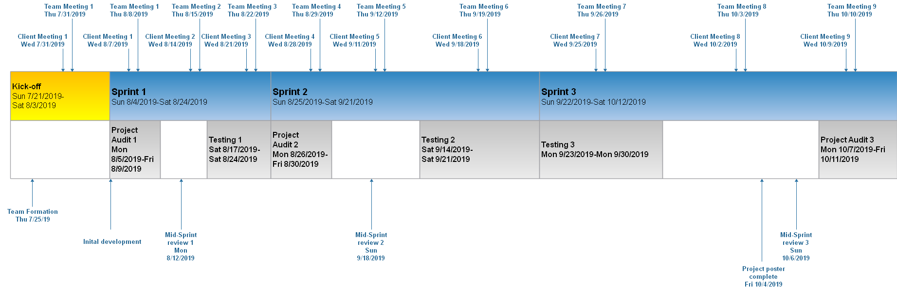
Project Schedule Kick-Off: Weeks 1 - 2. Sprint 1: Weeks 3 - 5. Sprint 2: Weeks 6 - 7. Sprint 3: Weeks 8 - 10.
Million Coursework Students
Kick-Off: Team member recruitment, onboarding, project definition and setup.
Sprint 1: Project Audit 1, graphical user interface, bug fixing.
Sprint 2: Project Audit 2, CRUD functions, copy function and bug fixing.
Sprint 3: Project Audit 3, paste function, access control and bug fixing.

Slide 5
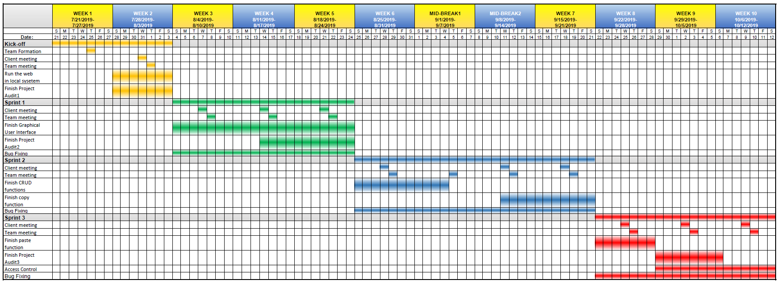
Million Coursework Students
Project Gantt

Slide 6
We are adopting SCRUM as our project-management methodology.
Million Coursework Students
TRACK of our Team management and communication
Project Repository-github repo-"million-coursework": https://github.com/million-coursework
Team communication tool-Slack channel： https://millioncourse.slack.com
Task management: Trello board "Million Course Project": https://trello.com/b/NZ6f3hWP/million-course-project
Contribution management: Google excel:https://docs.google.com/spreadsheets/d/1VDyPTPGakaePHO59xfDXeRE0bjdDeTqzyIgMXlnG3V4/edit?usp=sharing
Related links: GitHub organisation "AICourseSelection"： https://github.com/AICourseSelection

